Slide 1
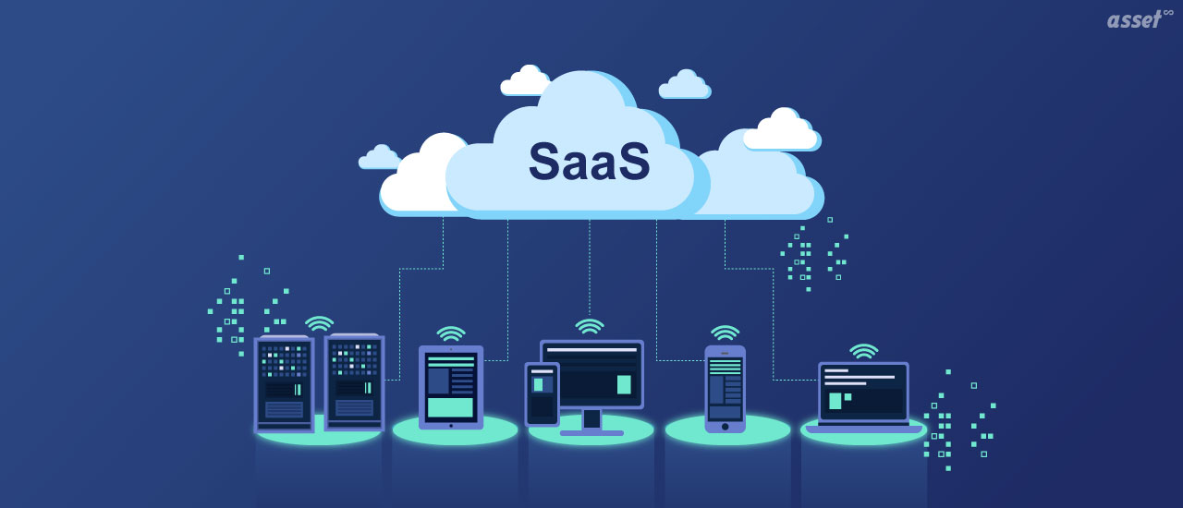
Software as a Service (SaaS)
By: Husnain Mohammad Masood
CS 131 Discrete Structures

Slide 2
What is SaaS?
Software-as-a-Service (SaaS) is a software licensing model in which access to the software is offered on a subscription basis, with the software being placed on external servers rather than on servers located in-house.
Software-as-a-Service (SaaS) is usually accessed with a web browser, by users logging into the system with a username and password. Instead of the user having to install the software on the computer, the user can access the program via the Internet.

Slide 3
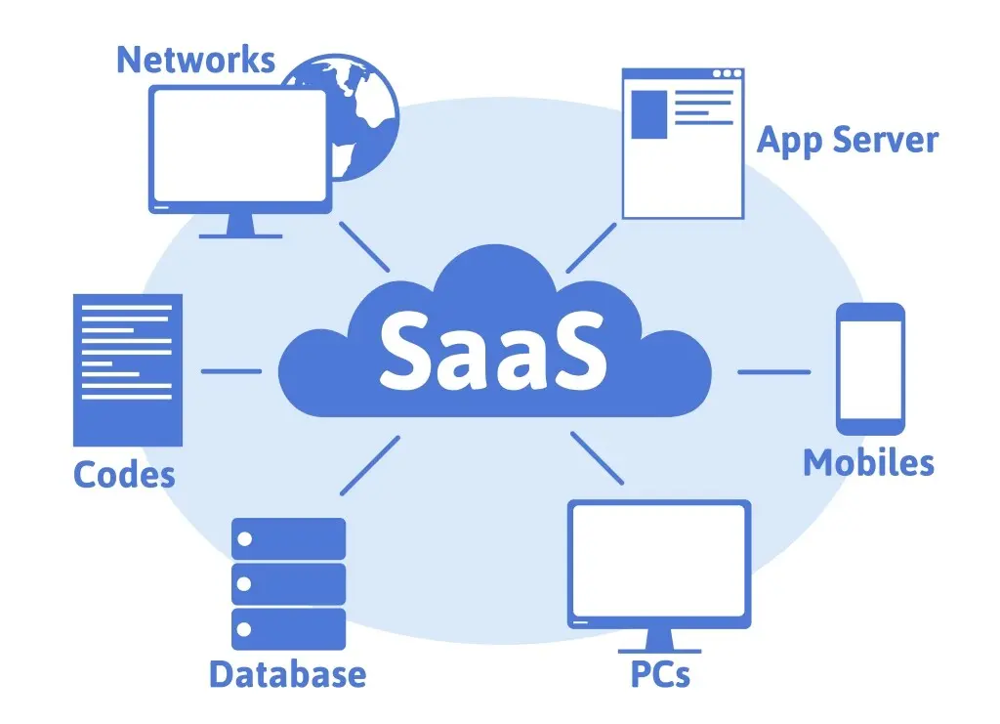
SaaS Architecture
SaaS architecture refers to a process of software delivery, in which a vendor hosts an application on a remote server for an organization before sending the app’s capabilities to that organization’s end users over the Internet.
The model permits numerous companies or organizations to share a single model and a single configuration which means that these organizations access the same hosted application, such as same hardware, operating system, network, and other components.

Slide 4
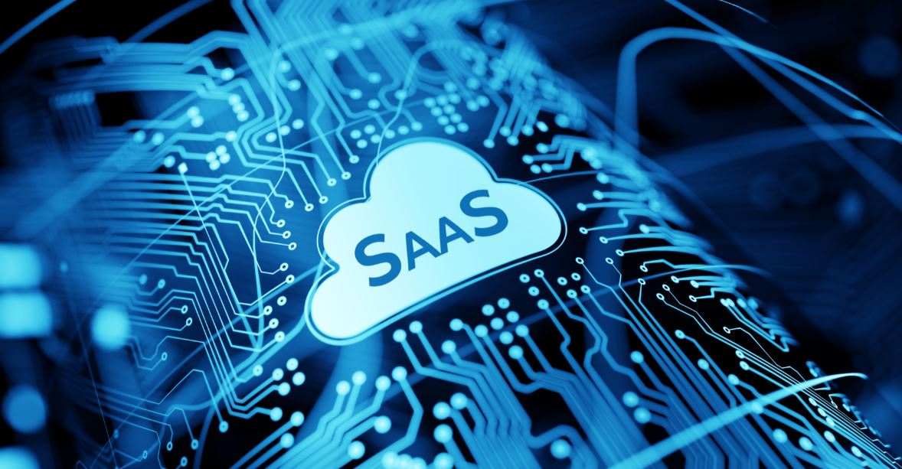
History of SaaS
SaaS goes back to its origins by a concept called time-sharing, which was created in the late 1950s and early 1960s to create more cost-effective use of costly processor time.
In 1999, Salesforce went all-in on SaaS by launching their own customer relationship management platform. It soon became the first icon thanks to its head start.
Today SaaS is global. With companies such as Adobe, Salesforce, and Shopify leading the way, its market is projected to reach $145 billion in 2022.

Slide 5
Advantages
Accessible from anywhere – SaaS vendors delivers applications over the internet; users can use it from any device with an internet.
Customization - SaaS applications are regularly customizable and can be combined with other business applications.
Scalable usage – SaaS offers high vertical scalability, which gives customers an option to access more or fewer services on demand.
Automatic updates – Instead of buying new software, customers can rely on the SaaS provider to automatically complete updates.

Slide 6
Challenges and Risks
Security – Cloud security is mostly cited as a major challenge for SaaS.
Issues beyond customer control – Issues can ascend when providers experience service disruptions, enforce unwanted changes to service offerings or experience a security breach.
Customers lose control over versioning – If the provider implements a new version of an application, it will roll out to its customers, regardless of the customer getting the newer version or not.
Difficulty switching vendors – Switching vendors can be problematic. To switch vendors, customers must transfer very large amounts of data.

Slide 7
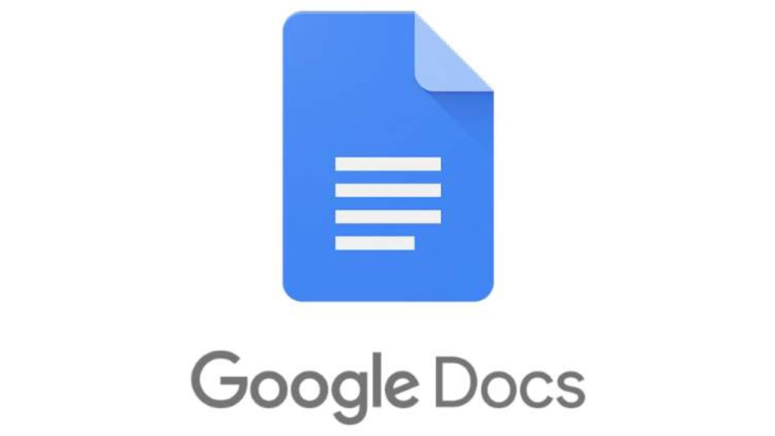
Example (1)
Google Docs
One real-world examples of SaaS is Google Docs, Google’s free online word processor
To use Google Docs, you log in on a web browser for instant access. It allows you to write, edit, and even collaborate with others wherever you are.
Google Docs established in October 2012.

Slide 8
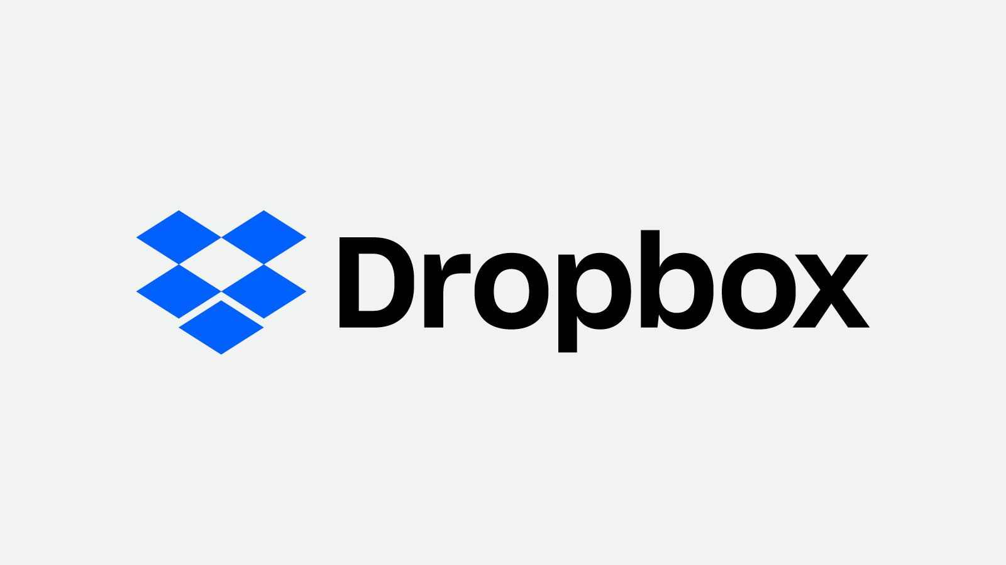
Example (2)
Dropbox
Another example of SaaS is Dropbox. Dropbox is a cloud storage that lets you store, share, and collaborate on files and data.
With Dropbox, users can back up and sync photos, videos, and other files to the cloud access them from any device, wherever you are.
Dropbox was launched in 2007.

Slide 9
Conclusion
They are benefits of SaaS platforms. When it is compared to traditional software solutions, there are lots of benefits and suppleness offered by SaaS solutions. It is possible to rent out a SaaS solution that lease a third-party company to make traditional software for your organization. Also, you can save time required for development of custom or traditional software solutions.

